Slide 1
ALKALYTICS A Data Management System for Ocean Alkalinity Enhancement
Team 21 – Sumanya Gulati, Kate Min, Jason Tran, Jennifer Ye
1/21

Slide 2
ROADMAP
01
02
03
04
PROJECT BACKGROUND AND PURPOSE
Purpose, current situation, current user pain points
LIVE DEMO
SOFTWARE DESIGN PROCESS
Key Features/Requirements, Testing, Feedback, UX/UI
LOOKING AHEAD
Stretch goals
2/21

Slide 3
01
BACKGROUND & PURPOSE
Learn about the impact of the project
3/21
Notes:
So, let's start by talking about what inspired the creation of this application.

Slide 4
THE CLIENTS
DR. CHARLES DE LANNOY
Head of the de Lannoy Lab, running experiments for Ocean Carbon Dioxide Removal
Bassel Abdelkader
Post-doctoral researcher, leading the experiments and current data collection
Notes:
Who are running experiments for Ocean CO2 Removal using the Ocean Alkalinity Enhancement Process

Slide 5


OCEAN ALKALINITY ENHANCEMENT EXPERIMENT PROCESS
Scalable process to capture CO2 emissions using Bipolar Membrane Electrodialysis (BMED) technology
BMED takes a salt solution → produce an alkaline solution to add back to oceans’ waters
The global perspective: shift ocean pH levels back to normal to increase ocean’s CO2 absorption and mitigate global temperature rise
4/21
Notes:
In the effort to combat the catastrophic impacts of global warming, they have been working on accelerating carbon emissions reduction efforts by rapidly scaling strategies to remove carbon dioxide (CO2) from the atmosphere and the oceans.

Slide 6
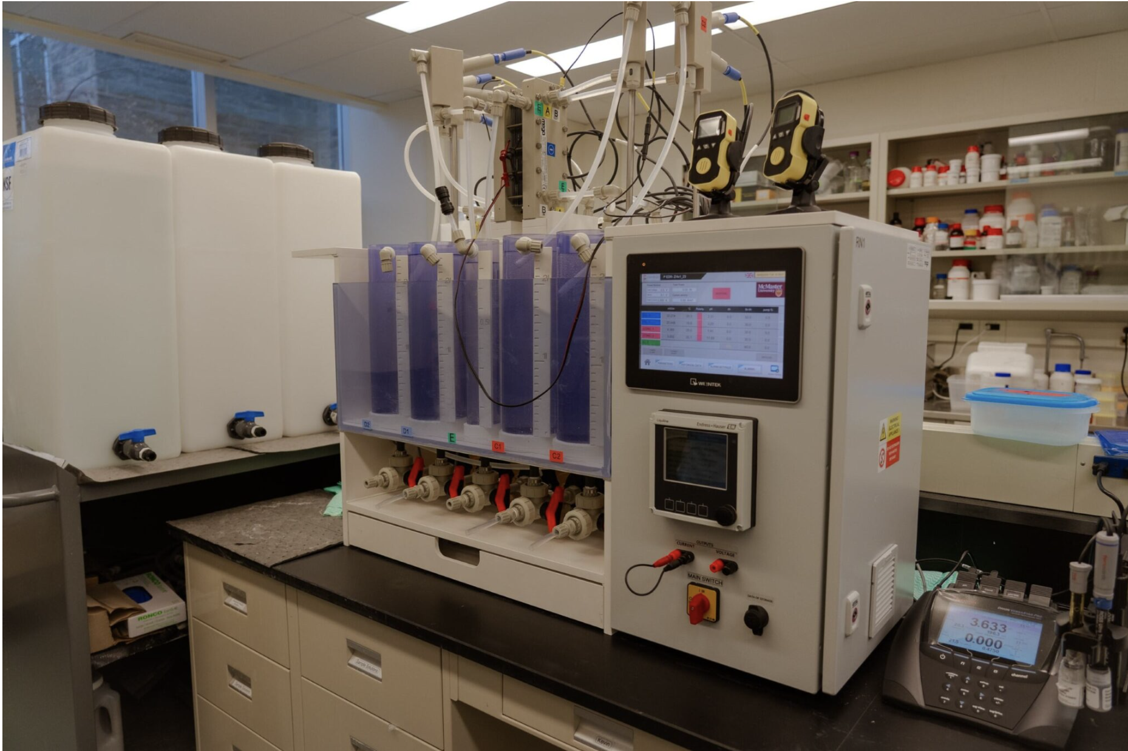
The bipolar membrane electrodialysis (BMED) system in the de Lannoy Lab at McMaster University.
Notes:
The inputs are simple: electricity, seawater and fresh water. The overall system components are more complex and include pumps, membranes electrodes, electrolyte, piping, gaskets, spacers and more. The output is a CSV file with 100s of rows of data points.

Slide 7
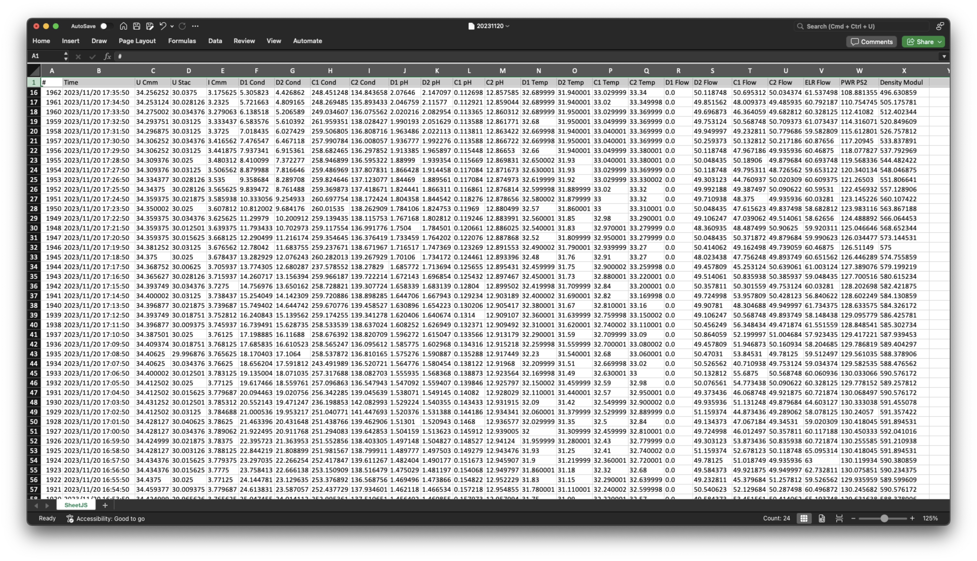
CURRENT SITUATION
DATA FROM MACHINE
A single Excel spreadsheet generated for every experiment
115 experiments conducted so far
5/21
Notes:
Now, we are all engineers in here. We all love a good excel sheet, don't we? But imagine having to deal with hundreds of these excel sheets, all of which contain valuable information and analyzing them so you can derive some meaningful insights. That sounds like a nightmare.

Slide 8
PROBLEM & PURPOSE
MORE EXPERIMENTS MUST BE CONDUCTED
LOTS OF DATA
Problem
SCALABILITY
CENTRALIZED SOLUTION
Purpose
6/21
Notes:
This problem is only exacerbated as the number of experiments increases producing more data. To combat this scalability issue, the team needs a cetralized solution. This is where we come in.

Slide 9

OUR SOLUTION
DASHBOARD
UPLOAD
DATA
GRAPHS
Quick overview of most recent information
CSV uploads to the database with validations
Centralizes all data
Allows calculations
Quick editing
Graph creation and analysis
7/21
Notes:
Our application, Alkalytics consists of 4 major components. First, we have the dashboard page which provides a quick overview of the most recent information relevant to the user. Next up, we have the Upload page. This is where the user uploads the generated CSV file. Our data migration algorithm processes and validates the data before converting it to the JSON format so it can be stored in our MongoDB database. Then, we have the Data page where all the uploaded files are consolidated. This page allows for quick editing and calculations and ee have replicated all the functionality that excel provides here. Lastly, we have the Graphs page that is used to visualize the data and analyze it. Now, let's see how the application works from the point of view of a researcher.

Slide 10
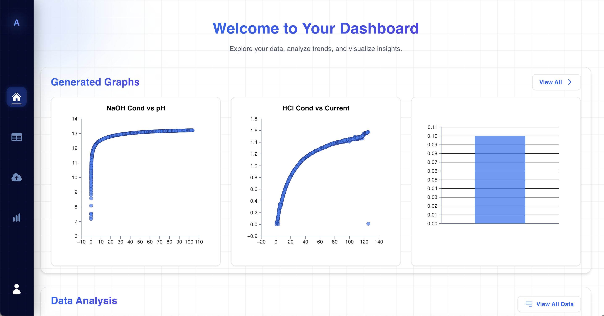
02
LIVE DEMO
8/21

Slide 11
03
SOFTWARE DESIGN PROCESS
Technology choices, Feedback, Usability
9/21

Slide 12






TECH-STACK
REACT + TYPESCRIPT + D3
MONGODB + GRAPHQL
Front end development, visualization library
Database development
JEST
PYTHON
Frontend testing
Backend development + testing
10/21

Slide 13
USABILITY TESTING
FEEDBACK |  | USER RATING | NOTES
1 | Navigation Ease |  | Both: "Somewhat Easy"
2 | Visual Appeal |  | M: 5/5, C:4/5
3 | Design Consistency |  | Both: "Consistent"
4 | Interface Clarity |  | M: "Very Clear"
5 | Learning Curve |  | Both: "Somewhat Easy"
6 | Responsiveness |  | Both: "No delays"
15/21
Notes:
Before we talk more about the SDLC process, I wanted to summarize the results of our latest usability testing session. We conducted the testing with two users – Prof de Lannoy himself and one of his research assistants, Meghna. We chose to have a limited user pool because this application serves a very niche purpose and we wanted to ensure that the users are familiar with the Ocean Alkalinity Enhancement Process.

Slide 14
HCI FOCUSED PRINCIPLES
USABILITY
ERROR PREVENTION AND RECOVERY
As easy to use as possible
Minimal effort to use the site
Validation and restriction enforced across all aspects
U
E
CONSISTENCY
AESTHETIC AND MINIMALIST DESIGN
A
HCI
C
Cohesive, uniform design and theme
Maximal functionality but minimal and clean design
FEEDBACK
USER CONTROL AND FREEDOM
F
U
Every action has a visual indication of what is happening
Nothing is irreversible. Elements can be edited or removed
16/21
Notes:
The Alkalytic project has a large emphasis on the user experience. In turn we focused on many of the HCL principles. Here are the core points.
The app is very simple to use. Minimal number of clicks needed to do the things users really want
A clean interface hides the complexities of the app, allowing users to focus on what really matters
For every action and button, there is feedback given so the user always knows what is going on with their clicks
We have built in validation to ensure data integrity across the entire site. There is no worry about entering the wrong things
We also have a uniform design throughout the app which means less time figuring out the ui and more time working on the actual data
Finally, experiments can get messy and things change. Nothing is permanent. The user is always incharge of what to edit, delete or revise!

Slide 15
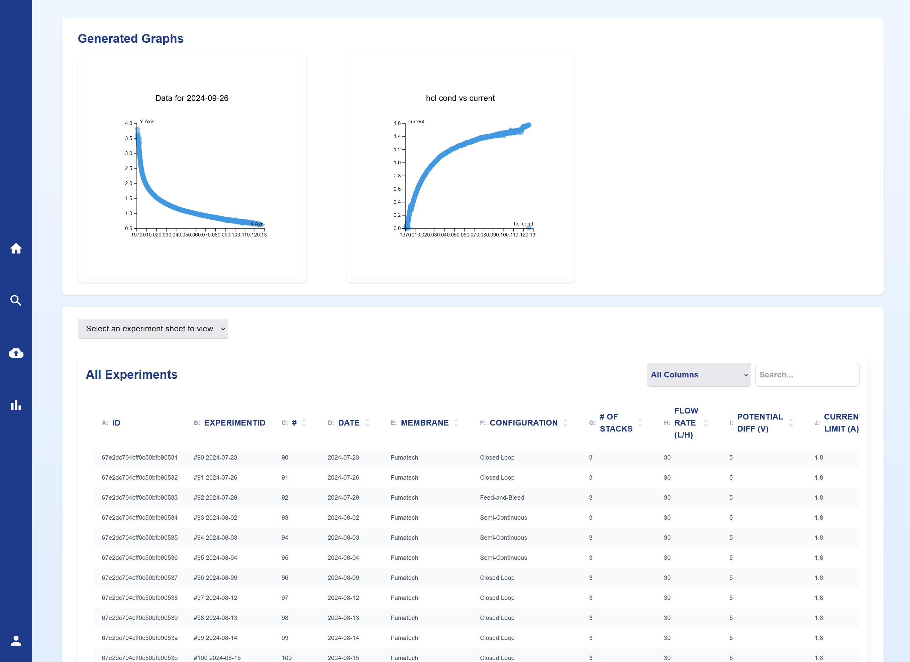
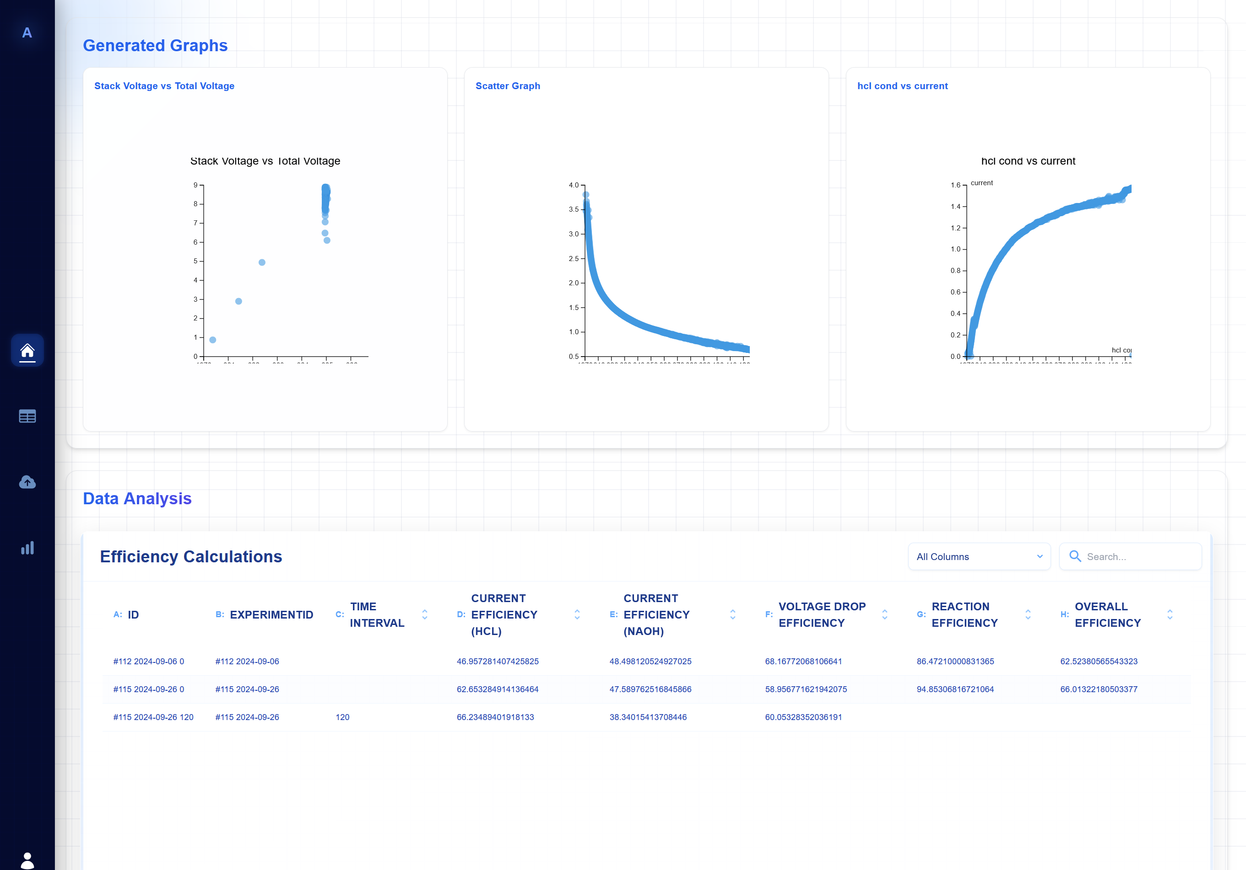
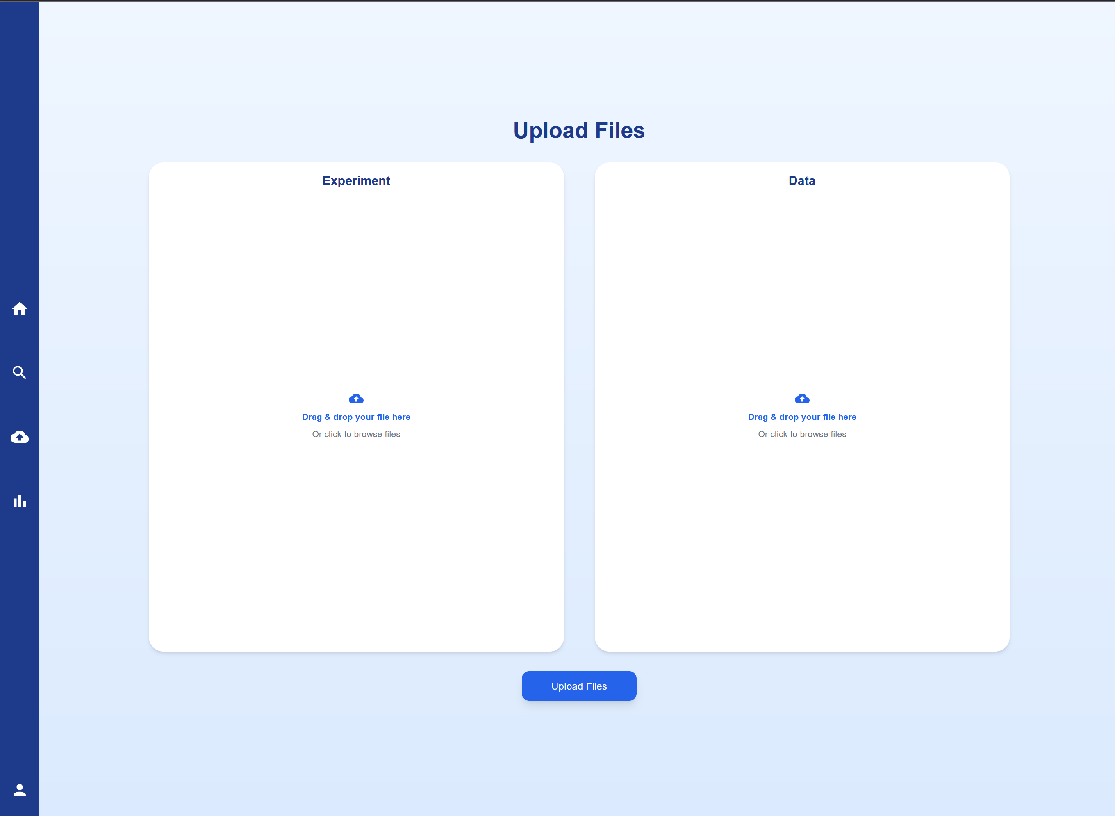
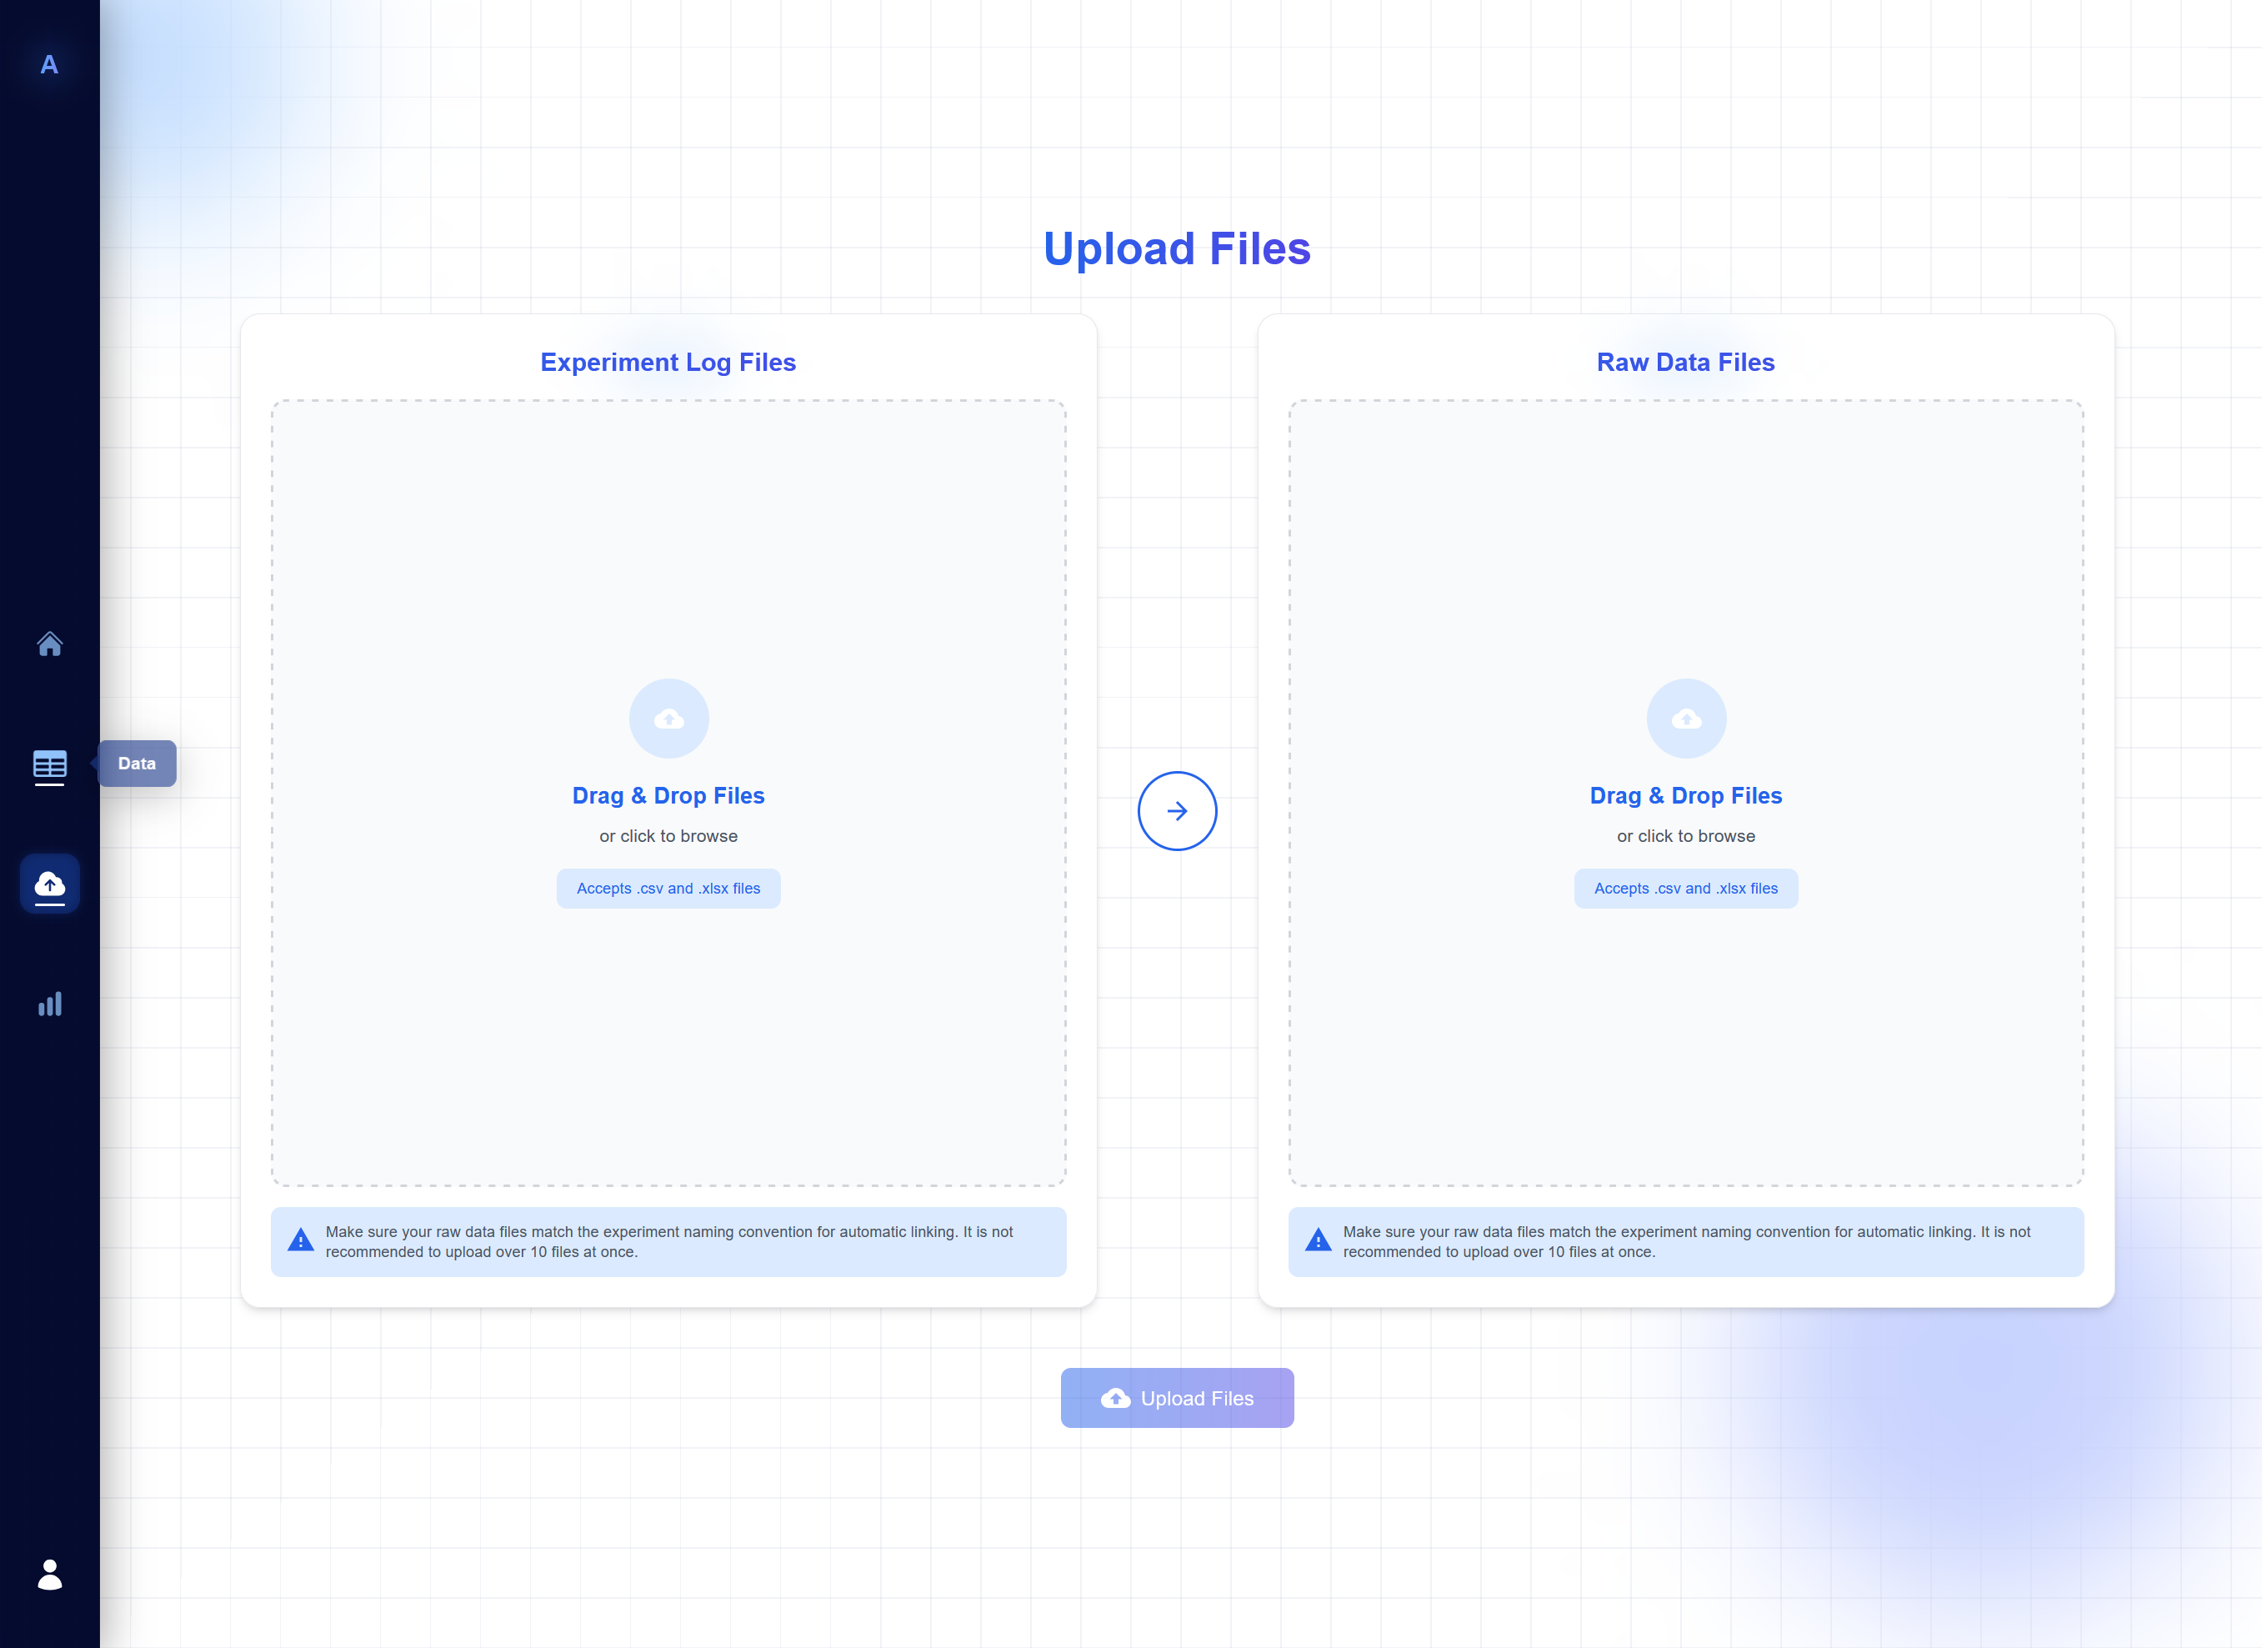
$10.000
17/21
Notes:
Here are two examples. On the left we have the old UI and on the right the current one.
You can see overall we had a change in theme to make it less bland and boring and more modern and easier for the eyes with the changes in colours and icons to be more cohesive overall.
In the bottom example, you an also see some more info to better help the user understand the page which increases usability.

Slide 16
CLIENT FEEDBACK
ADDED FEATURES
BETTER USER FLOW
Calculating efficiency factors based on work from undergrad research assistant
Original user flow was not helpful based on the user’s needs
11/21
Notes:
Along with the feedback about the user experience and interface, we received additional feedback from our client and supervisor following our Rev 0 Demo.
Two of the most critical feedback included the implementation of calculating efficiency factors which was demonstrated earlier,
as well as some user flow changes as our previous user flow was not 100% suited to the users’s needs.

Slide 17
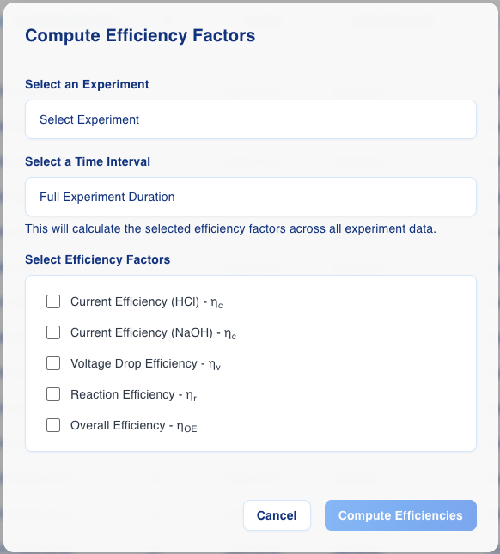
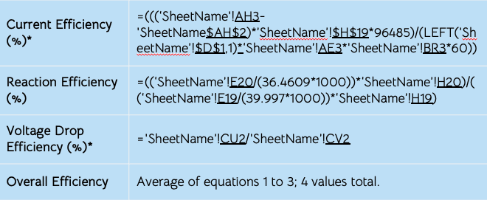
EFFICIENCY FACTORS
Adapted from: Saha, M. “Bipolar Membrane Electrodialysis Device Optimization Final Presentation”.
12/21
Notes:
So as seen in the demo, there were a variety of efficiency factors that we were able to compute on a set of data.
For context, these factors measure different efficiencies of the membrane that’s used in the experiment, which includes current efficiencies for different compounds, a reaction efficiency, voltage drop efficiency, and the overall efficiency, and these factors help the research team determine which experiments may have had more optimal initial settings over others and vice versa.
On your left, you can see the very complex excel formulae that needs to be applied to a single spreadsheet and it requires a lot of manual inputs by the person trying to compute each efficiency factor.
We adapted this into a simple to use modal that allows the user to just select the experiment, the time interval of the experiment to analyze, and then the efficiency factors that they want to see for that subset of data.
Once submitted, the backend extracts the data for the given experiment and computes the efficiency factors based on the excel formulae using the numpy library.

Slide 18
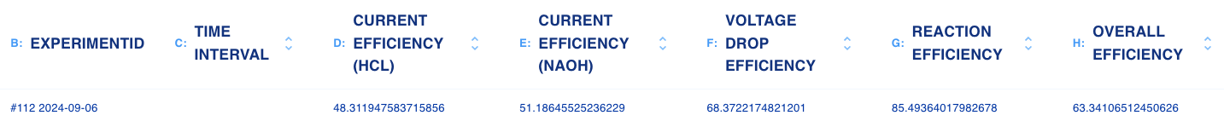
EFFICIENCY CALCULATIONS
Adapted from: Saha, M. “Bipolar Membrane Electrodialysis Device Optimization Analysis Finalized Format”.
13/21
Notes:
In terms of verification for this feature, it was introduced to us as a new requirement a bit later on into the term, so a lot of the verification had to be a manual comparison.
As you can see here, the factors on top were the results of an example analysis that the research team did, and underneath are the results that our application computes for them.
There is some discrepancies between Excel’s computation and ours due to factors such as floating point errors and some differences in the interpolation, but overall this feature is important to the analysis of the membrane efficiency and finding the ideal parameters for an expanded global scale of the production process.

Slide 19
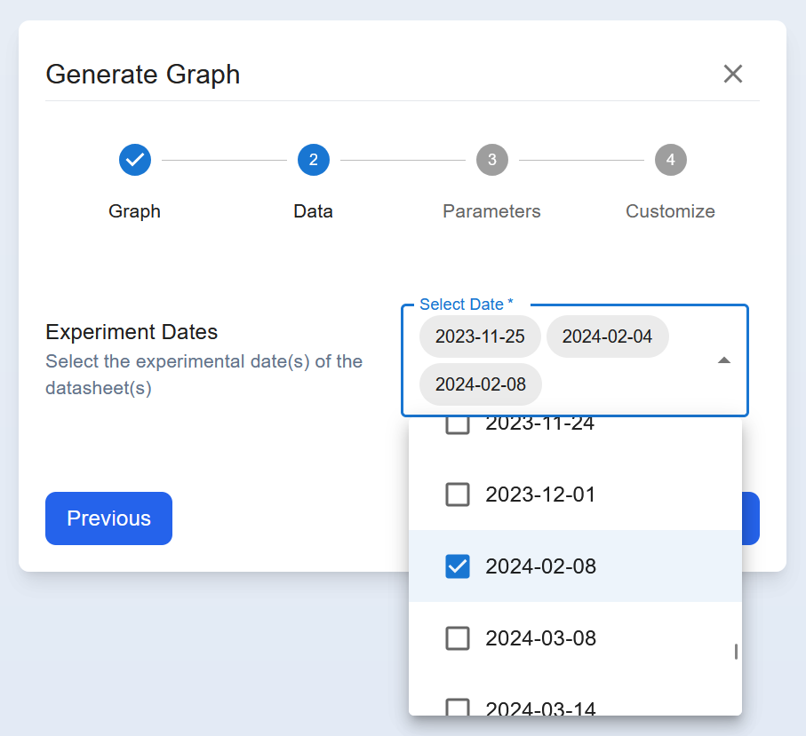
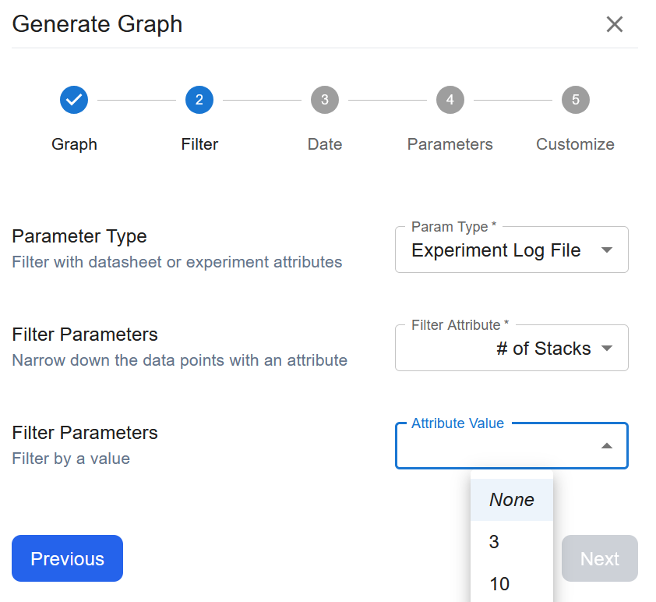
USER FLOW CHANGE
GRAPH → DATES → PARAMETERS → CUSTOMIZE
GRAPH → FILTER → DATE → PARAMETERS → CUSTOMIZE
14/21

Slide 20
04
LOOKING AHEAD
Stretch goals, optimization
18/21
Notes:
We’ll touch on what’s ahead for this project, including some of our stretch goals that were identified in our requirements gathering stage and further optimization.

Slide 21
FUTURE IMPROVEMENTS
 | DATA ANALYSIS | PERFORMANCE
CURRENT | Linear regression, Efficiency factors | Fast lookups, data retrieval, and calculations
FUTURE | Machine Learning (ML) Integration, Principal Component Analysis (PCA) | Further optimization of visualization rendering Handle even larger datasets
19/21
Notes:
Two key aspects of our application center around the data analysis as well as performance.
In terms of data analysis, our application is already capable of performing a linear regression and computing efficiency factors on a given data set and in the future, which could be expanded to integrate machine learning algorithms and provide the ability to perform a Principal Component Analysis, which is a dimensionality reduction method that can provide more insight into the data.
In terms of performance, our application is already capable of fast lookups, fast data retrieval, and fast calculations as well as visual rendering. In the future, this could be further optimized to handle even larger datasets as the experiment study continues to expand.

Slide 22
HIGHLIGHTS OF THE ALKALYTICS PROJECT
CHALLENGES
IMPACT
Consolidating massive amounts of experiment data
Tedious and slow workflow
Weak foundation for future development
Centralized data system
Graphical analysis
All-in-one custom solution
User-friendly interface
20/21

Slide 23
THANK YOU!
Questions?
21/21

Slide 24
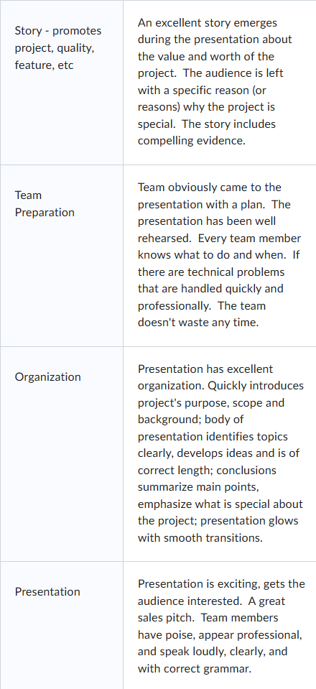

Slide 25
ALTERNATIVE RESOURCES
Here’s an assortment of alternative resources whose style fits the one of this template:
Gradient black friday vertical flyer template

Slide 26
DECISIONS: NEW MARKET, NEW PRODUCT & NEW COMPANY
DESIRABILITY
What is the potential demand for our product in this new market?
PROFITABILITY
FEASIBILITY
What will be the profitability of this strategic initiative?
What is the feasibility to enter this new market?
SWEET SPOT

Slide 27
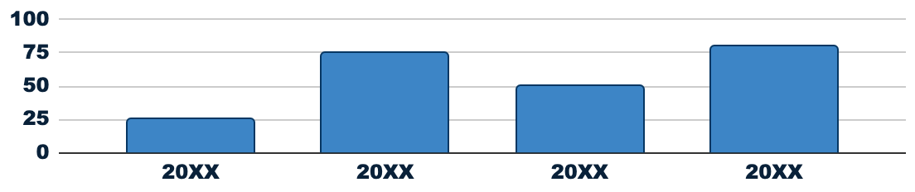
STRONG BUSINESS CASE
PROJECT COSTS
$4M
TANGIBLE BENEFITS
$14M
NET PRESENT VALUE
$8M
CASH FLOW (US $ MILLION)
CHANGE IMPACT
Low
Medium
High
INTANGIBLE BENEFITS
STRATEGIC ALIGNMENT
RESOURCES
Follow the link in the graph to modify its data and then paste the new one here. For more info, click here
Insert your own text here
Insert your own text here
SPONSOR:
Sponsor name
MANAGER:
Manager name

Slide 28
IMPLEMENT, TRACK & MANAGE
PROGRESS
STATUS
LINK
Venus
40%
www.yourlinkhere.com
Mars
35%
www.yourlinkhere.com
Saturn
70%
www.yourlinkhere.com
Jupiter
15%
www.yourlinkhere.com
Earth
85%
www.yourlinkhere.com
Ceres
60%
www.yourlinkhere.com

Slide 29
WATERFALL MANAGEMENT PLAN
REQUIREMENTS
Mercury is the closest planet to the Sun
DESIGN
Venus is the second planet from the Sun
IMPLEMENTATION
Jupiter is the biggest planet of them all
VERIFICATION
Saturn is a gas giant with several rings around
MAINTENANCE
Despite being red, Mars is actually very cold

